Slide 1

ANI – an anime tracker and recommendation website

Slide 2

Actual project

Slide 3
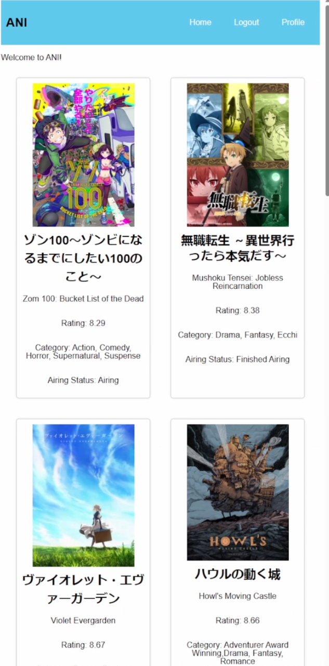

Landing Page
Adapts to the size of the screen

Slide 4
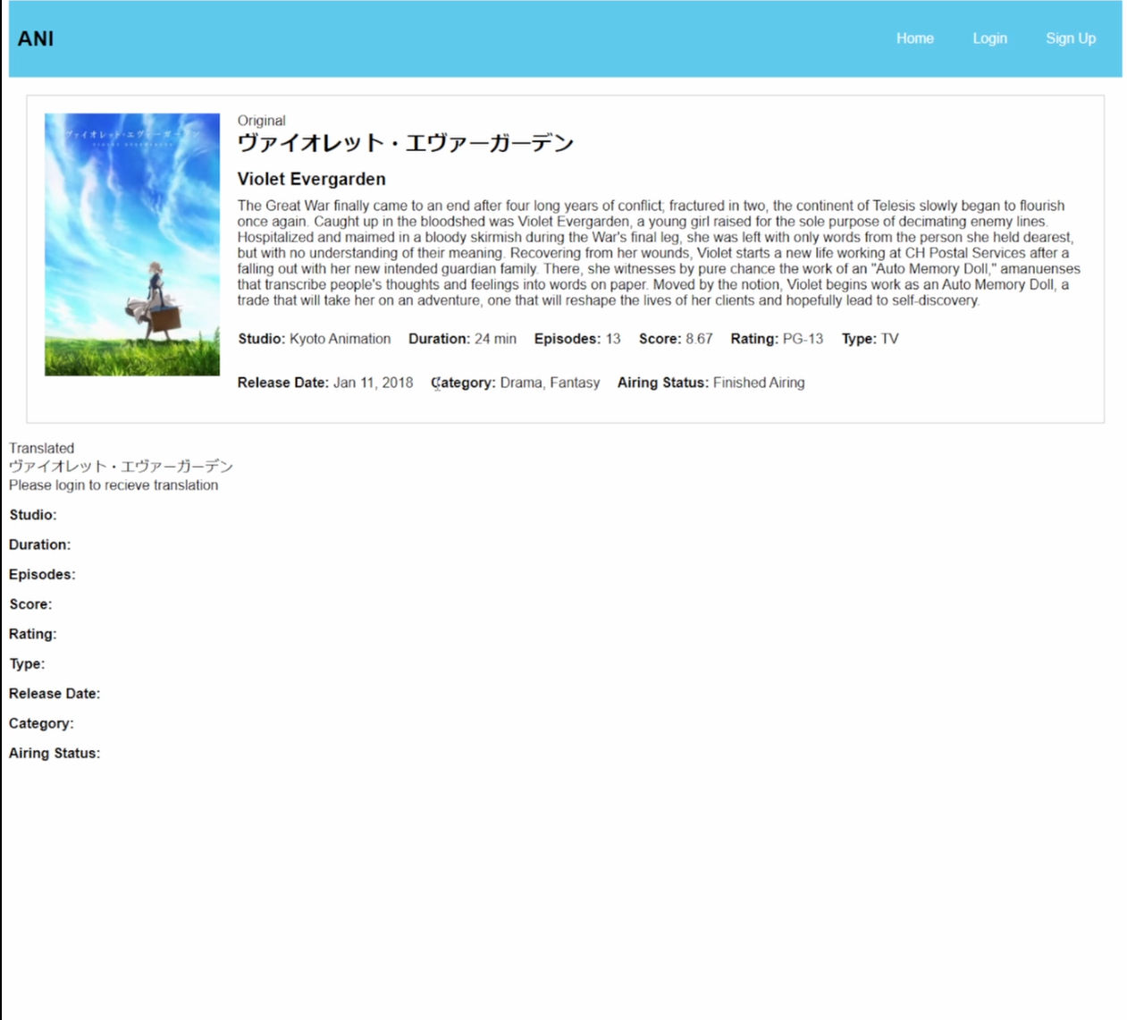
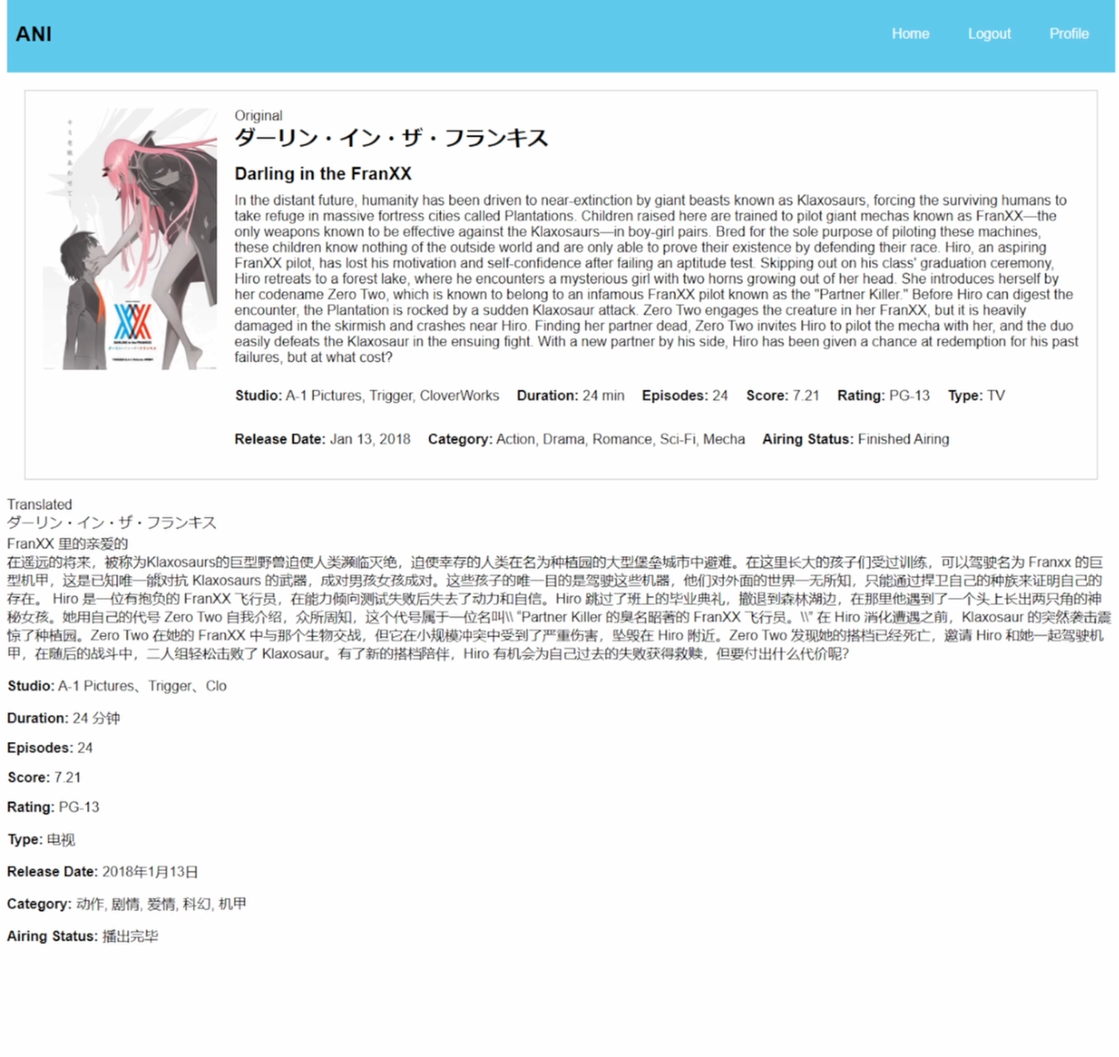
Information page
Translates the information of the anime from English to other languages

Slide 5
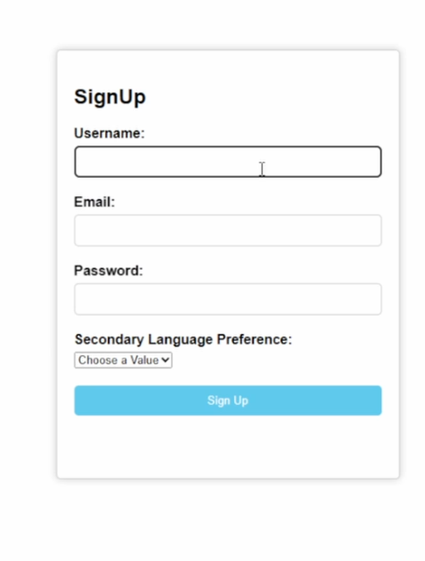
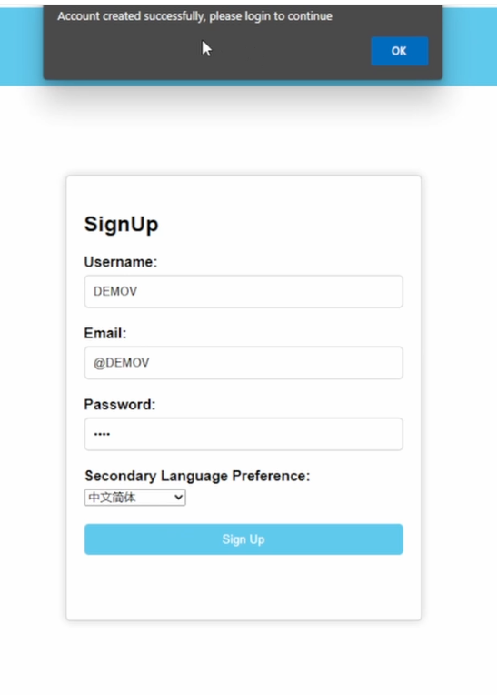
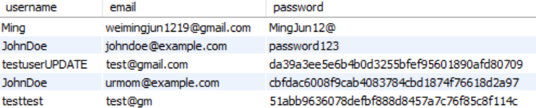
Account Creation

Slide 6
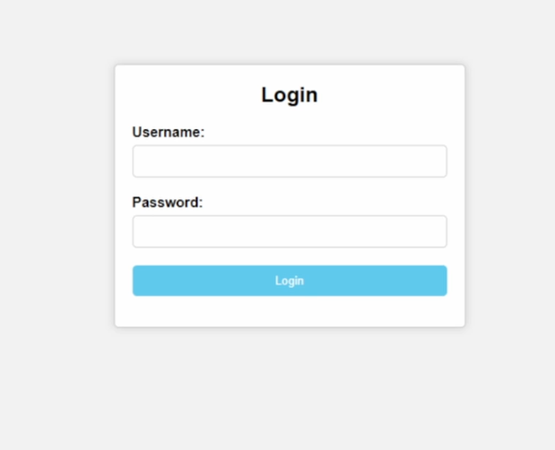
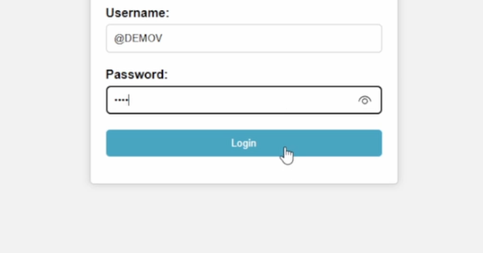
Login

Slide 7
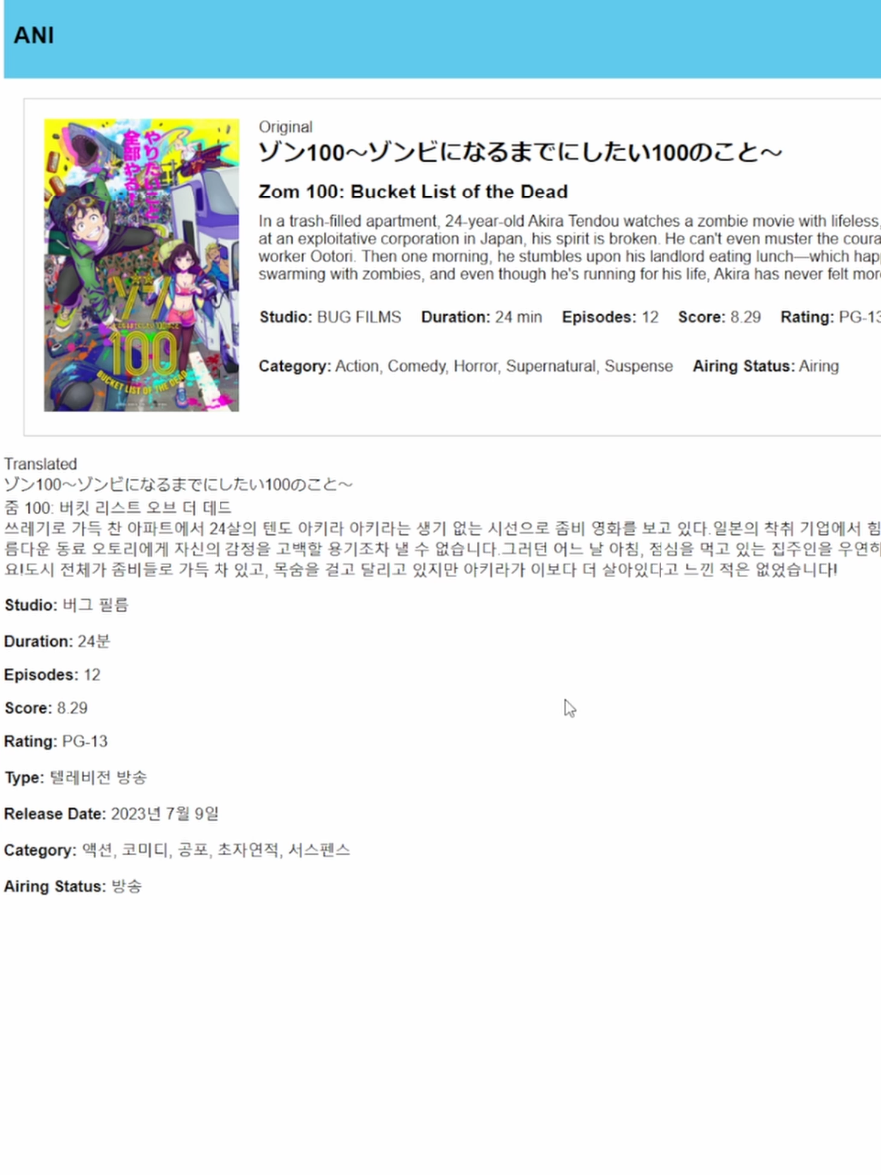
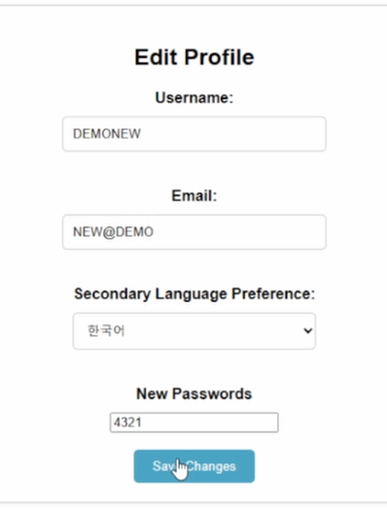
Edit profile
Editing the language preference also changes the translated language

Slide 8

Planning

Slide 9
Deployment method: Serverless
No server management
Reduces the workload of planning, configuring, and managing servers allows one to focus on the website’s functionality rather than hardware details.
Flexible scaling
can scale up and down dynamically based on incoming traffic without any configuration, downtime, or lag. This makes the website resistant to traffic influx
Cost effective
eliminates server maintenance costs, and allows for flexible scaling, saving operational costs and allowing for a focus on building the website and user experience.
Notes:
Serverless deployment
Serverless deployment is chosen as it have many benefits like
No server management
There’s the reduced work of planning for provisioning, configuring and management of servers which reduces the workload significantly and allows me to focus my work on the actual website and how it works instead of the hardware details
Flexible scaling
This allows the website to scale up and down dynamically based on the incoming traffic at different times of the year, day and hour. All these is done without any kind of configuration, downtime and lag in the website. This ensures that my website is rather resistant to traffic influx unlike a server deployment where traffic influx have to be taken into consideration when configuring the server.

Slide 10
Website features
Core Features
Login
Sign up
Main Page
Display of anime information
Not core Features
Edit user info
Translating information
Comments/forum
Watchlist of animes

Slide 11



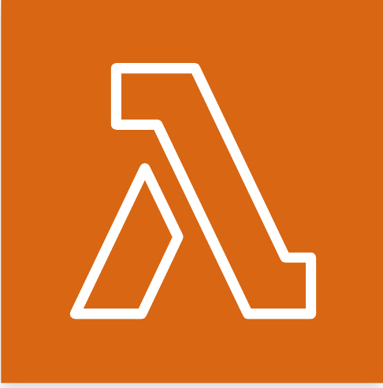

How to make it work
Storage
DynamoDB
RDS
S3 bucket
Security
Password encryption
Access control
Requests
Lambda function
Api Gateway
Deployment
Amplify

Slide 12
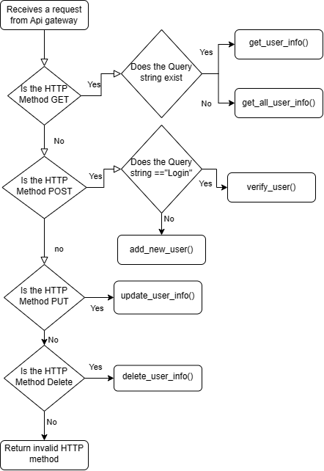
Code Logic

Slide 13

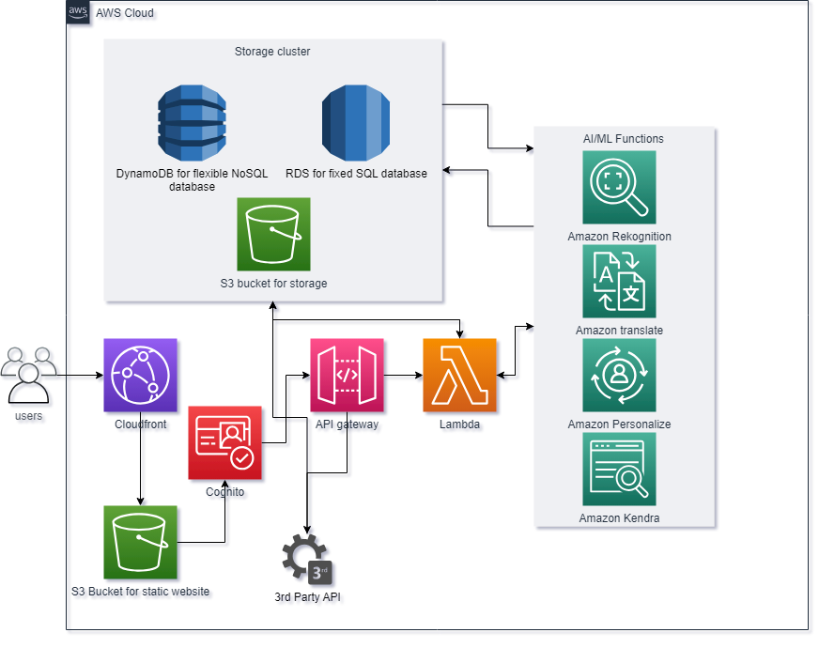
Cloud Architecture Overview

Slide 14
Thank You

